Slide 1
만성 간질환에서의 전해질 및 신기능 이상
2009. 10. 17.
중앙의대 이재욱

Slide 2
Contents
Pathophysiology
Vasodilatation and hyperdynamic circulation
Impaired response to vasoconstrictors
Clinical disorders
Hyponatremia
Ascites
Hepatorenal syndrome (HRS)
Management of hyponatremia
V₂ receptor antagonist
Management of HRS
Vasoconstrictors
Other agents
TIPS and peritoneovenous shunt
Renal replacement therapies
Prevention
Albumin infusion
Norfloxacin

Slide 3
Contents
Pathophysiology
Vasodilatation and hyperdynamic circulation
Impaired response to vasoconstrictors
Clinical disorders
Hyponatremia
Ascites
Hepatorenal syndrome (HRS)
Management of hyponatremia
V₂ receptor antagonist
Management of HRS
Vasoconstrictors
Other agents
TIPS and peritoneovenous shunt
Renal replacement therapies
Prevention
Albumin infusion
Norfloxacin

Slide 4
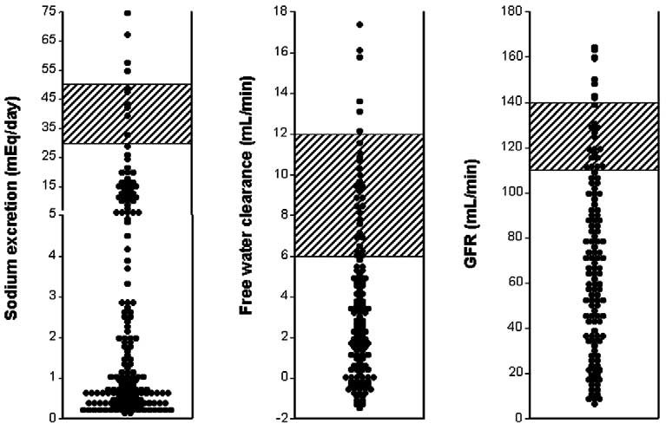
Renal dysfunction in cirrhosis
Impaired natriuresis
Impaired free water excretion
Decrease in renal perfusion and GFR
Arroyo V et al. J Hepatology 38:S69-S89

Slide 5
Pathophysiology Peripheral arterial vasodilatation & hyperdynamic circulation
Portal hypertension
Splanchnic/systemic vasodilatation
Cardiac output
Effective arterial blood volume
High-output
Heart failure
Neurohormonal activation
(RAAS, SNS, AVP)
Low-output
Heart failure
Na⁺ and water retention
Renal vasoconstriction
Ascites and hyponatremia
Renal blood flow
Hepatorenal syndrome

Slide 6
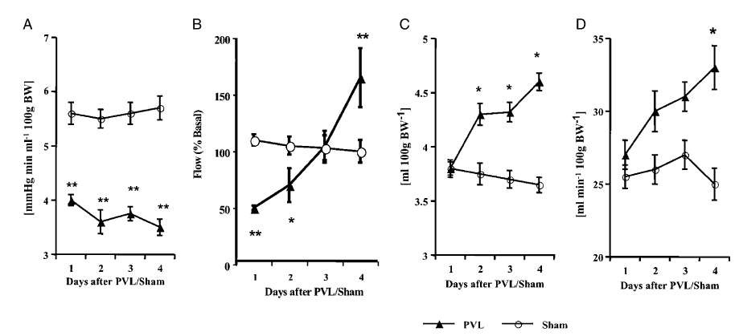
Hyperdynamic circulation Mechanisms
Splanchnic blood flow after portal-vein ligation
Colombato LA et al. Hepatology. 1992;15:323–328.
Total peripheral
resistance
SMA blood flow
Plasma volume
Cardiac index

Slide 7
Hyperdynamic circulation Mechanisms
Portal hypertension
Bacterial translocation
Endotoxins
Pro-inflammatory cytokines
Vasodilating mediators
↓Vascular reactivity to vasoconstrictors
Vasorelaxation
NO
EDHF
CO
CGRP
ANP
Vasoconstrictors
SNS
RAAS
Vasopressin
Vascular Tone
Vasodilatation
Vasoconstriction
Wiest R et al. J Clin Gastroenterol 276:S272-S287

Slide 8
Hyperdynamic circulation Mechanisms: The Role of Nitric Oxide
In vivo evidence
Increased sensitivity to the pressor effect of NO inhibition
Nonspecific NO inhibitor (L-NAME) normalizes
cGMP concentration
cardiac index
arterial pressure
total vascular resistance

Slide 9
Hyperdynamic circulation Mechanisms: The Role of Nitric Oxide
In vitro evidence
In vitro evidence
Hyporesponsiveness to vasoconstrictors is mainly localized to the endothelium.
Inhibition of NO synthesis restores vascular reactivity to normal levels.
Upregulation of eNOS in the superior mesenteric arterial endothelium
Impaired aortic responsiveness to vasoconstrictors
Mediated largely by endothelium-derived NO
Increased pulmonary NO synthesis
A key component in the development of hepato-pulmonary syndrome

Slide 10
Hyperdynamic circulation Mechanisms: The Role of Nitric Oxide
Time course of of splanchnic blood flow
Colombato LA et al. Hepatology. 1992;15:323–328.
Total peripheral
resistance
SMA blood flow
Plasma volume
Cardiac index

Slide 11
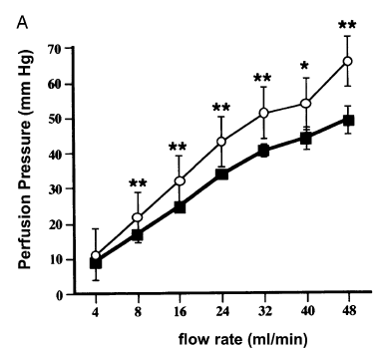
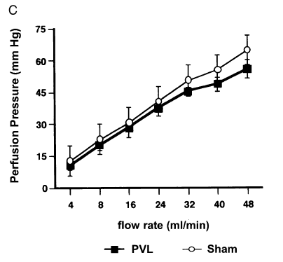
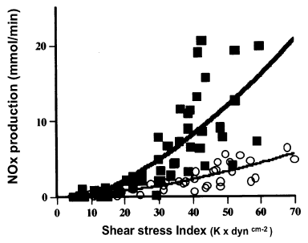
Hyperdynamic circulation Mechanisms: The Role of Nitric Oxide
Time course of NO production
Shear stress-mediated NO release in mesenteric arteries of PVL ligation rats (day 3 after PVL)
Wiest R et al. Am J Physiol 1999;276:G1043-G1051

Slide 12
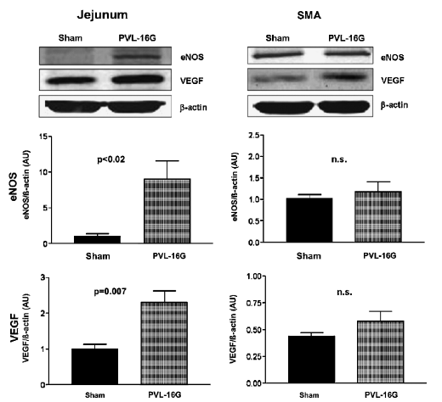
Hyperdynamic circulation Mechanisms: The Role of Nitric Oxide
Low-level PV ligation
eNOS upregulation at the intestinal mucosa and mesenteric arteries at day 1 after PVL
Marked upregulation of VEGF
Not associated with changes in mesenteric arterial blood flow or resistance
Attenuation of eNOS upregulation after VEGF receptor blockade
Wiest R et al. Am J Physiol 1999;276:G1043-G1051

Slide 13
Hyperdynamic circulation Mechanisms: The Role of Nitric Oxide
Stimulus for vascular NO overproduction
Shear stress
Mesenteric vasoconstriction → cyclic strain
Signals located at the intestinal microcirculation
VEGF
TNF in the conditions of bacterial translocation
Circulating eNOS-activating hormones

Slide 14
Hyperdynamic circulation Mechanisms
Portal hypertension
Endothelial stretching
Shear stress
VEGF
eNOS activity
NO
NO
Splanchnic vasodilatation
NO
Peripheral vasodilatation
Effective arterial blood volume
Porto-systemic shunt
Na⁺ and water retention
Shear stress
mediated by flow
Cirrhosis
Hyperdynamic state
Bacterial translocation:
Endotoxins, TNF-alpha
Endocannabinoids
eNOS activity & protein expression

Slide 15
Hyperdynamic circulation Other factors
EDHF
Prostaglandins
Heme oxygenase and carbon monoxide

Slide 16
Impaired response to vasoconstrictors
Impaired vascular reactivity to angiotensin in BDL rats
↓Rho-kinase activity in VSMC
Reduced Ca²⁺ sensitivity
Increased myosin light chain phosphorylation

Slide 17
Contents
Pathophysiology
Vasodilatation and hyperdynamic circulation
Impaired response to vasoconstrictors
Clinical disorders
Hyponatremia
Ascites
Hepatorenal syndrome (HRS)
Management of hyponatremia
V₂ receptor antagonist
Management of HRS
Vasoconstrictors
Other agents
TIPS and peritoneovenous shunt
Renal replacement therapies
Prevention
Albumin infusion
Norfloxacin

Slide 18
Renal dysfunction in cirrhosis
Phases
Description
Na⁺ metabolism
Free water clearance
Renal perfusion/GFR
1
Compensated cirrhosis
Normal just in the limit of regular Na⁺ intake
Normal
Normal
2
Renal Na⁺ retention without activation of vasoconstrictor system
Unable to excrete regular Na⁺ intake;
urine Na⁺ 50-90 mEq/d
Normal
Normal; circulatory dysfunction exists
3
Stimulation of endogenous vasoconstrictor system
Impaired;
Urine Na⁺ < 10 mEq/d
Impaired; mild [Na⁺]↓
Normal or modestly reduced
4
HRS-2
Urine Na⁺ < 10 mEq/d
Refractory ascites
[Na⁺]↓
Moderate GFR↓
5
HRS-1
*Precipitating factors
Urine Na⁺ < 10 mEq/d
Refractory ascites
[Na⁺]↓
Severe GFR↓

Slide 19
Hyponatremia in cirrhosis
Water retention  dilutional hyponatremia
Diuretics
↓Tissue perfusion  impairing free water excretion
Most likely occur with rapid fluid removal in patients with ascites and no peripheral edema

Slide 20
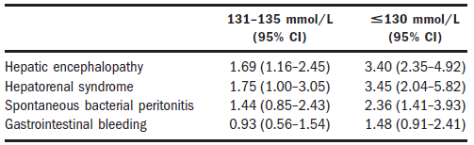
Hyponatremia in cirrhosis
Prevalence
< 135 mmol/L: 50%
< 130 mmol/L : 22%
< 125 mmol/L : 6%
< 120 mmol/L : 1%
Associated in a graded fashion with:
Severe ascites
Impaired renal function
Hepatic encephalopathy
Spontaneous bacterial peritonitis
Hepatorenal syndrome
Angeli P et al. Hepatology 44:1535-1542

Slide 21
Contents
Pathophysiology
Vasodilatation and hyperdynamic circulation
Impaired response to vasoconstrictors
Clinical disorders
Hyponatremia
Ascites
Hepatorenal syndrome (HRS)
Management of hyponatremia
V₂ receptor antagonist
Management of HRS
Vasoconstrictors
Other agents
TIPS and peritoneovenous shunt
Renal replacement therapies
Prevention
Albumin infusion
Norfloxacin

Slide 22
Hepatorenal syndrome Definition: the original concepts in 1994
Renal failure in HRS is functional and caused by marked intrarenal vasoconstriction.
HRS occurs in patients with systemic circulatory dysfunction caused by extrarenal vasodilatation.
Plasma volume expansion does not improve renal failure.
Arroyo V et al. Hepatology 23:165-176

Slide 23
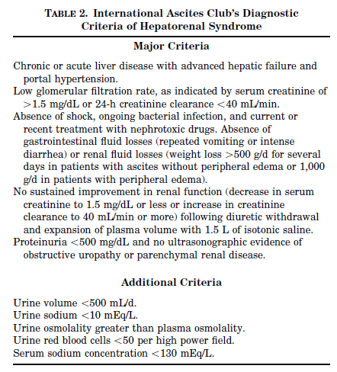
Hepatorenal syndrome Diagnostic criteria (1994)
Renal failure in HRS is functional and caused by marked intrarenal vasoconstriction.
HRS occurs in patients with systemic circulatory dysfunction caused by extrarenal vasodilatation.
Plasma volume expansion does not improve renal failure.
Arroyo V et al. Hepatology 23:165-176

Slide 24
Hepatorenal syndrome Definition
Type 1 HRS
Rapid progressive renal failure defined by doubling of the initial serum Cr to a level greater than 2.5 mg/dL in less than 2 weeks.
Type 2 HRS
Moderate renal failure (serum Cr from 1.5 to 2.5 mg/dL), with a steady or slowly progressive course.
Salerno F et al. Gut 2008;56:1310-1318

Slide 25
Hepatorenal syndrome New concepts (2007)
Extra-renal arterial vasodilatation occurs mainly in the splanchnic vascular bed.
Cardiac output in patients with HRS is insufficient for the patient’s needs.
The most common trigger for the development of type-1 HRS is bacterial infection, mainly spontaneous bacterial peritonitis (SBP).
Renal function can be improved by medical treatment and is associated with improved survival.
Salerno F et al. Gut 2008;56:1310-1318

Slide 26
Hepatorenal syndrome New diagnostic criteria (2007)
Cirrhosis with ascites
Serum Cr > 1.5 mg/dL
No improvement of serum Cr after at least 2 days with diuretic withdrawal and volume expansion with albumin
Recommended dose of albumin : 1 g/kg of body weight per day up to a maximum of 100 g/day.
Absence of shock
No current or recent treatment with nephrotoxic drugs
Absence of parenchymal kidney disease
Proteinuria > 500 mg/day
Microscopic hematuria (>50 red blood cells per high power field) and/or
Abnormal renal US
Salerno F et al. Gut 2008;56:1310-1318

Slide 27
Hepatorenal syndrome 1994 vs. 2007
Ccr has been excluded.
More complicated than S-Cr
Does not increase the accuracy of renal function estimation
Renal failure in the setting of ongoing bacterial infection is now considered HRS.
Treatment of HRS can be started without waiting for complete recovery from the infection.
Plasma volume expansion should be performed with albumin rather than saline.
Minor diagnostic criteria have been removed as they are not essential.
Salerno F et al. Gut 2008;56:1310-1318

Slide 28
Contents
Pathophysiology
Vasodilatation and hyperdynamic circulation
Impaired response to vasoconstrictors
Clinical disorders
Hyponatremia
Ascites
Hepatorenal syndrome (HRS)
Management of hyponatremia
V₂ receptor antagonist
Management of HRS
Vasoconstrictors
Other agents
TIPS and peritoneovenous shunt
Renal replacement therapies
Prevention
Albumin infusion
Norfloxacin

Slide 29
Hyponatremia: management
Restriction of free water intake
Hypertonic saline
V₂ receptor antagonist

Slide 30
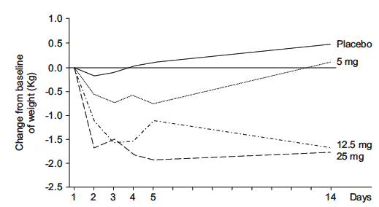
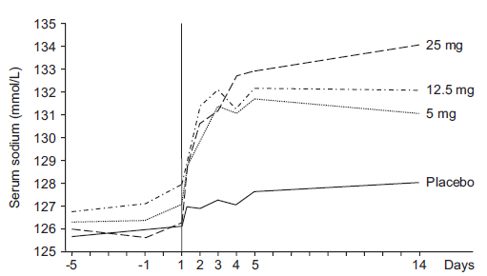
V₂ receptor antagonist Satavaptan for cirrhotic ascites
Body weight
Urine volume
Urine osmolality
Serum [Na⁺]↑
No change in serum Cr or estimated GFR
Little change in serum and urine [K⁺]
Serum [Na⁺]
Gines P et al. Hepatology 2008;48:204-213

Slide 31
Contents
Pathophysiology
Vasodilatation and hyperdynamic circulation
Impaired response to vasoconstrictors
Clinical disorders
Hyponatremia
Ascites
Hepatorenal syndrome (HRS)
Management of hyponatremia
V₂ receptor antagonist
Management of HRS
Vasoconstrictors
Other agents
TIPS and peritoneovenous shunt
Renal replacement therapies
Prevention
Albumin infusion
Norfloxacin

Slide 32
Ideal treatment for HRS
Improving renal perfusion and GFR
Reduction of serum Cr to < 1.5 mg/dL
Prolongation of survival
Avoidance of serious adverse events

Slide 33
Systemic vasoconstrictors
↓Splanchnic vasodilatation
↑ Arterial pressure
Suppression of vasodilators
In combination with plasma volume expanders
Plasma albumin

Slide 34
Vasopressin analogues
Ornipressin and terlipressin
Nonselective splanchnic vasoconstrictors → portal pressure↓
Act on V₁ receptors on VSMCs
Reverse the overactivity of SNS and RAS
Stimulate ANP release

Slide 35
Vasopressin analogues
Terlipressin
Improvement in renal function in 63% (42-92%)
Mean arterial pressure↑
Systemic vascular resistance↑
Cardiac output↓
No reduction in renal blood flow
Most trials were retrospective, involving small numbers of patients

Slide 36
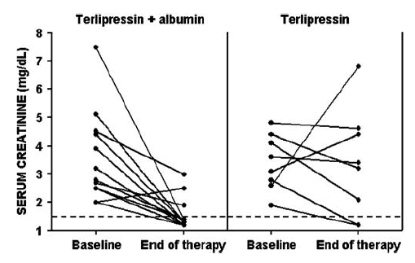
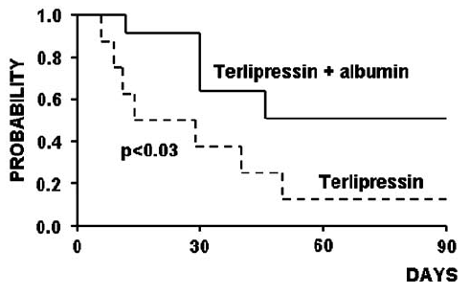
Vasopressin analogues
Terlipressin + albumin
Complete reversal of HRS↑
Increase in BP
Suppression of renin-aldosterone system
Terlipressin alone: not so effective
Ortega R et al. Hepatology 36:941-948

Slide 37
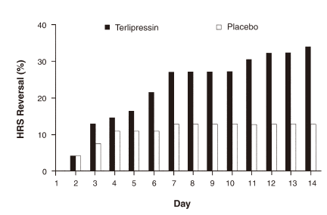
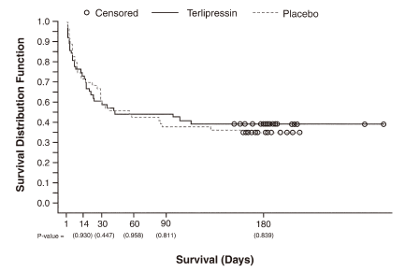
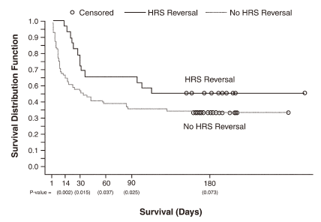
Vasopressin analogues
Terlipressin vs. placebo
Reversal of HRS
34% vs. 13%
Overall survival
no difference
If reversal of HRS(+) : survival gain(+)
Sanyal AJ et al. Gastroenterology 134:1360-1368

Slide 38
Vasopressin analogues
Terlipressin
Optimal dose and duration : not well defined
0.5 mg IV every 4 hours  maximum : 12 mg/d
Dose can be increased in a stepwise fashion.
Should be continued until HRS improves.
Relapse of HRS : 50%
Retreatment may be effective

Slide 39
Vasopressin analogues
Terlipressin: adverse effects
Ischemic complications (15%)
Acts as a cerebral vasodilator
Should be avoided in:
Older patients with a history of coronary heart disease, cerebrovascular disease, hypertension, or asthma

Slide 40
Vasopressin analogues
Ineffective in some patients
Mechanism other than vasoconstriction/vasodilatation?
Coronary vasoconstriction → cardiac output↓
Reduced arterial reactivity to vasoconstrictor

Slide 41
Alpha-adrenergic agonists
Midodrine
An oral alpha-adrenergic agonist
Combination with octreotide
Midodrine: vasoconstrictor
Octreotide: inhibitor of the release of endogenous vasodilators (glucagon, VIP)

Slide 42
Alpha-adrenergic agonists
Norepinephrine
12 patients
Norepinephrine (0.5 – 3 mg/h) + albumin
For > 5 days
Reversal of HRS in 10 patients
Renin, aldosterone↓
Blood pressure↑
Duvoux C et al. Hepatology 2002;36:374-380

Slide 43
Recommendations
Type 1 HRS에 대한 vasoconstrictor 사용
1. 치료 목표: serum Cr < 1.5 mg/dL
2. 권장 약물 및 용량 Terlipressin 0.5 mg IV q4-6h. 2-3일마다 증량하여 1 mg/4 hr까지 증량 최대용량은 2 mg/4 hr Midodrine 2.5-7.5 mg po tid (최대 12.5 mg tid) plus Octreotide 100 mcg SC tid (최대 200 mcg tid) Norepinephrine 0.5-3 mg/hr IV
3. Albumin infusion 병용: 20-40 g/day after 1 g/kg on the first day
4. Terlipressin 금기: 관상동맥질환, 뇌혈관질환, 고혈압, 천식
Salerno F et al. Gut 2008;56:1310-1318

Slide 44
Other agents
Misoprostol
N-acetylcysteine
ACE inhibitors: should not be used in HRS

Slide 45
TIPS
Used in the treatment of refractory ascites
Improvement in renal function may be delayed.
Survival for patients with type 1 HRS: 5 months
Cannot be recommended for MELD score > 18
Median survival < 3 months

Slide 46
Renal replacement therapies
Indications
Patients awaiting a liver transplant
Possibility of improvement in liver function(+)
Modalities
Intermittent HD
Continuous renal replacement therapies
Ascites reinfusion dialysis
Molecular adsorbents recirculating system (MARS)

Slide 47
Contents
Pathophysiology
Vasodilatation and hyperdynamic circulation
Impaired response to vasoconstrictors
Clinical disorders
Hyponatremia
Ascites
Hepatorenal syndrome (HRS)
Management of hyponatremia
V₂ receptor antagonist
Management of HRS
Vasoconstrictors
Other agents
TIPS and peritoneovenous shunt
Renal replacement therapies
Prevention
Albumin infusion
Norfloxacin

Slide 48
Prevention of HRS
Albumin infusion
Norfloxacin

Slide 49
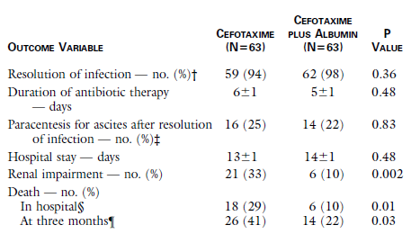
Albumin infusion
In patients with SBP
Method
IV albumin 1.5 g/kg at the time of diagnosis of SBP
Another dose of albumin 1.0 g/kg on day 3 of antibiotic treatment
Renal impairment↓, survival ↑ at 3 months
Sort P et al. N Engl J Med 1999;341:403-409

Slide 50
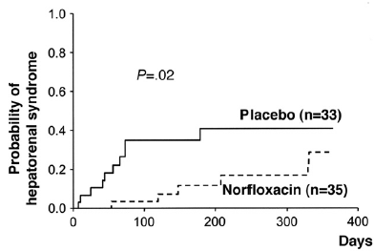
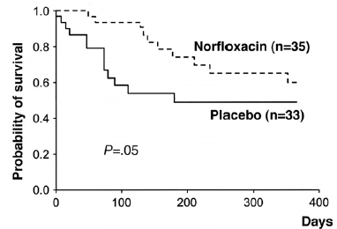
Norfloxacin
Norfloxacin 400 mg/day
Indications
Ascitic fluid total protein < 1.5 g/dL
Child-Pugh score > 9 and serum bilirubin > 3 mg/dL
S-Cr ≥ 1.2 mg/dL or BUN ≥ 25 mg/dL or Na ≤ 130 mEq/L
Fernandez J et al. Gastroenterology 2007;133:818-824

Slide 51
Summary
Renal dysfunction in chronic liver disease
Hyperdynamic circulation
Hyponatremia
Role of V2 receptor antagonist
HRS is potentially reversible.
Vasoconstrictor + albumin

