Slide 1
Therapeutic approach to hypertensive crisis
Difficult Cases
Jae Yoon Park
Nephrology, Dongguk University Ilsan Hospital

Slide 2
Agenda
Definition
Complications and prognosis
Causes
Evaluation
Management

Slide 3
Case 1
F/32
CC : Dyspnea
PI :
5년 전 임신 당시 혈압이 많이 높아 고혈압약을 먹었음. 출산 이후에 혈압이 호전된 것은 아니었으나 치료의 필요성을 잘 느끼지 못해 치료를 안 받아옴. 약 3주 전부터 숨찬 증상이 있어 인근 의원 방문하였다가 수축기 혈압 200 이상으로 나오고 심장비대도 있어 큰 병원 진료를 권유 받고 내원함.
BP 182/112 (의원에서 처방받은 혈압약 복합제를 먹고 잰 상태)
Ht/Wt 155.1/84.5

Slide 4
Case 1
CBC 9,010 - 13.9 - 201K - Neut 70.6%
BUN/Cr 20.2/1.6
E’ 139 - 4.9 - 100 - 29.1, Calcium/Phosphorus 9.8/4.0
Total protein/Albumin 7.4/4.6, glucose 102, cholesterol 215
Total bilirubin 0.7, AST/ALT/ALP 13/12/102, LDH 202
U/A SG 1.025, pH 5.0, protein 2+, blood -, RBC 0-1/HPF, WBC 10-29/HPF

Slide 5
Case 2
F/17
CC : Headache
PI :
이전부터 학교 건강검진에서 혈압 160-170 나오곤 했으나 특별한 검사 나 치료를 받지 않았음. 3일 전부터 시야가 가려지고 흐려지는 증상이 있어 인근 안과 의원 방문하여 고혈압성 망막변화가 와있고, 혈압이 180 이상으로 높아 큰 병원 권유 받고 내원함.
V/S 220/160 - 60 - 20 - 36.6
Ht/Wt 155.8/68.5

Slide 6
Case 2
CBC 16,650 - 14.5 - 361K - Neut 72.3%
BUN/Cr 5.6/0.4
E’ 139 - 3.2 - 94 - 27, Calcium/Phosphorus 9.6/-
Total protein/Albumin 8.1/4.7, glucose 91, cholesterol 199, CRP 2.15
Total bilirubin 1.3, AST/ALT/ALP 16/19/125, LDH 285
U/A SG 1.015, pH 6.5, protein 1+, blood +/-, RBC 1-4/HPF, WBC 0-1/HPF

Slide 7
Definition
Hypertensive crisis (from JNC guideline)
SBP > 179 mmHg or DBP > 108 mmHg
*Acute target organ involvement
Y
N
Hypertensive emergency
Hypertensive urgency
*Acute target organ involvement
- Hypertensive encephalopathy, sympathetic crisis, perioperative hypertension, acute aortic dissection,
acute coronary event, SAH or CVA, pre-eclampsia or eclampsia of pregnancy

Slide 8
Complications and prognosis
40% were alive after 33 months¹
- Cause of death : renal failure (39.7%), stroke (23.8%), MI (11%), HF (10.3%)
1-year mortality rate is 79%²
¹Lip GY et al. J Hypertens, 1995; 13: 915-924
²Varon J et al. Crit Care, 2003; 7: 374-384

Slide 9
Causes
Uncontrolled essential hypertension
Cerebrovascular conditions
Hypertensive encephalopathy
Ischemic stroke
ICH
Eclampsia, pre-eclampsia
Renal diseases
Acute glomerulonephritis
Renovascular hypertension
Renal crises from systemic sclerosis
Post-renal transplantation
Renal malformation
Endocrine diseases
Pheochromocytoma
Cushing syndrome
Primary aldosteronism
Cardiac diseases
Acute aortic dissection
Acute left-ventricular failure
Post-coronary artery bypass
Acute coronary syndrome
Aortic coarctation
Drug-induced hypertension
Cocaine
Amphetamine
SSRI, MAOI
Rebound hypertension
PostOP
Head injuries and CNS trauma
Autonomic hyperactivity (Guillain-Barre syndrome)
Vasculitis

Slide 10
Evaluation
Medical history
- Medication including previous antihypertensive therapy
- Comorbidities
Coronary artery diseases
Congestive heart failure
Cerebrovascular disease
Peripheral vascular disease
Renal disease
DM, etc.
Notes:
LE – lower extremities

Slide 11
Evaluation
Physical examination
- BP measurement on both arms with appropriate size cuff
- If significant BP difference as seen in the setting of acute aortic dissection → LE BP check
- Auscultation
Abdominal murmurs (renovascular HTN)
Heart sound and murmurs (HF, aortic coarctation or stenosis)
Pulmonary rales
- Motor or sensory neurological defects
- Fundoscopy (abnormalities in the retina)
- Intravascular volume status with estimation of jugular venous pressure and peripheral edema
- LE pulses
Notes:
LE – lower extremities

Slide 12
Evaluation
Initial laboratory studies
- Should be limited and rapidly exedited
- U/A with microscopy
Significant proteinuria, RBCs, cellular casts are suggestive of renal parenchymal disease
- Chemistry panel
Electrolyte abnormalities, particularly hypoK, hypoMg
Evidence of renal or hepatic dysfunction
- ECG should immediately be obtained
Evidence of coronary ischemia, LVH
- Simple chest X-ray (cardiomegaly, pulmonary edema)
- Brain CT or MRI if there is evidence of neurologic deficit from P/E
Notes:
LE – lower extremities

Slide 13
Management
SBP > 180 mmHg or DBP > 120 mmHg
*Target organ damage new/progressive/worsening
Y
N
Hypertensive emergency
Hypertensive urgency
Admit to ICU
Reinstitute/intensify oral antiHTN drug therapy
and arrange follow-up
Next page
2107 ACC Guideline for the prevention, detection, evaluation, and management of high blood pressure in adults

Slide 14
Management
Hypertensive emergency
Admit to ICU
Aortic dissection
Severe pre-eclampsia or eclampsia
Phechromocytoma crisis
Y
N
Reduce SBP to < 140 mmHg
During 1st h and to < 120 mmHg
in aortic dissection
Reduce BP by max 25% over 1st h,
then to 160/100-110 mmHg over next 2-6 h,
Then to normal over next 24-48 h
2107 ACC Guideline for the prevention, detection, evaluation, and management of high blood pressure in adults

Slide 15
Drug | Category | Onset | Duration | Metabolism | Dosing | Special notes | Adverse reactions
Nicardipine | CCB | 5-15 min | 3 h | Hepatic | Initial 5 mg/h Titrated up by 2.5mg/h every 5 min Maximum of 15 mg/h | Highly selective for coronary and cerebral vasculature It can be used in acute ischemic stroke | Angina, peripheral edema, tachycardia, headache
Labetalol | α1 and β receptor blocker | 2-5 min | 2-4 h | Hepatic | Loading dose 20mg Followed by boluses of 20–80mg every 10 min or titrated to a continuous infusion 1–2mg/min Maximum dose of 300mg | Drug of choice during pregnancy Contraindicated in preexisting heart block, asthma, bradycardia and severe CHF | Bradycardia, dizziness, drowsiness, nausea
Esmolol | Cardio-selective β blocker | 60 s | 10-20 min | RBC esterases | 0.5 mg/kg loading dose for 60 s Continuous infusion starting at 50mg/kg/min Maximum 300mg/kg/min | Preferred agent during aortic dissection | Bradycardia, nausea, injection site pain
Phentolamine | Pure α- antagonist | seconds | 15 min | Hepatic | Starting dose is 1–5mg IV boluses | Agent of choice in catecholamine-induced HTN-E | Bradycardia, mouth pain, headache, angina

Slide 16
Drug | Category | Onset | Duration | Metabolism | Dosing | Special notes | Adverse reactions
Nitroglycerin | Nitrate | 2-5 min | 3-5 min | Mainly Hepatic | Initial dose 5mg/kg/min Titrated up by 5mg/kg/min every 3–5 min. After the dose 20mg/kg/min, can be increased by 20mg/kg/min | Preferred agent in acute coronary syndrome, pulmonary edema, acute aortic dissection (with a β-blocker) | Headache, dizziness, increased intracranial pressure
Sodium nitroprusside | Nitrate | seconds | 1-2 min | RBCs Hepatic Renal | Initial dose of 0.25–0.3mg/kg/min Titrated up by 0.5mg/kg/min until reaching BP goal | Contraindicated renal failure and hereditary optic nerve atrophy It should be used only when other IV antihypertensive drugs are not available. | Coronary steal phenomenon (it may trigger acute MI), increased ICP, decreased cerebral blood flow
Curr Opin Cardiol 2017;32:397-406

Slide 17
Pharmacologic agents according to clinical condition
Cardiology in Review 2010;18:102-107

Slide 18
Case 1
F/32
CC : Dyspnea
PI :
5년 전 임신 당시 혈압이 많이 높아 고혈압약을 먹었음. 출산 이후에 혈압이 호전된 것은 아니었으나 치료의 필요성을 잘 느끼지 못해 치료를 안 받아옴. 약 3주 전부터 숨찬 증상이 있어 인근 의원 방문하였다가 수축기 혈압 200 이상으로 나오고 심장비대도 있어 큰 병원 진료를 권유 받고 내원함.
BP 182/112 (의원에서 처방받은 CCB/ARB 혈압약 복합제를 먹고 잰 상태)
Ht/Wt 155.1/84.5

Slide 19
Case 1
CBC 9,010 - 13.9 - 201K - Neut 70.6%
BUN/Cr 20.2/1.6
E’ 139 - 4.9 - 100 - 29.1, Calcium/Phosphorus 9.8/4.0
Total protein/Albumin 7.4/4.6, glucose 102, cholesterol 215
Total bilirubin 0.7, AST/ALT/ALP 13/12/102, LDH 202
U/A SG 1.025, pH 5.0, protein 2+, blood -, RBC 0-1/HPF, WBC 10-29/HPF

Slide 20
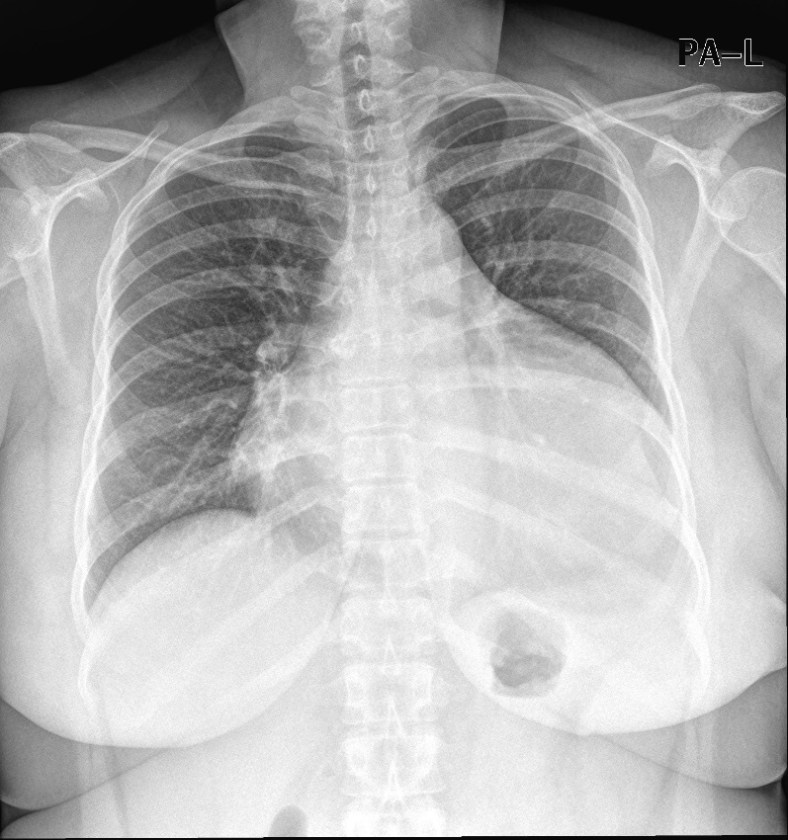
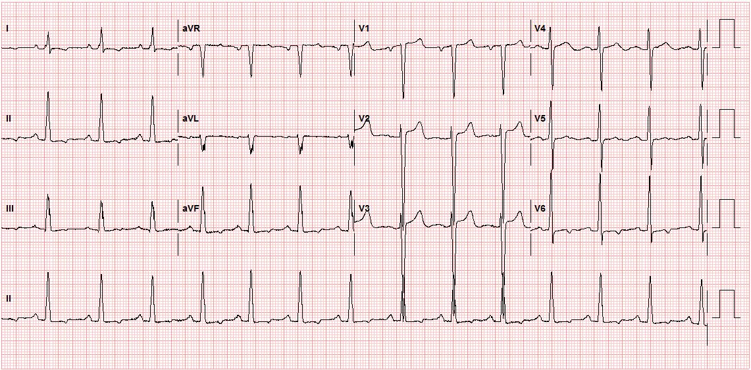
Case 1
ARB 포함된 기존 약제 중단
IV nicardipine continuous infusion 하며 조절
Cardiac enzyme: normal

Slide 21
Case 1
Renin activity 4.87 ng/mL/hr, aldosterone 32.8 ng/dL
Random urine protein/creatinine 56.9/98.4
TFT : normal
24hrs urine
- VMA 4.7 mg, epinephrine 2.8 ug, norepinephrine 23.2 ug, metanephrine 0.4mg
Kidney Doppler US : LK 12.3 cm, RK not seen
EchoCG
- EF 52%
- No regional wall motion abnormality
- Dilated LV cavity and increased LV wall thickness
- Grade 1 diastolic dysfunction with dialted LA
→ C/W hypertensive heart

Slide 22
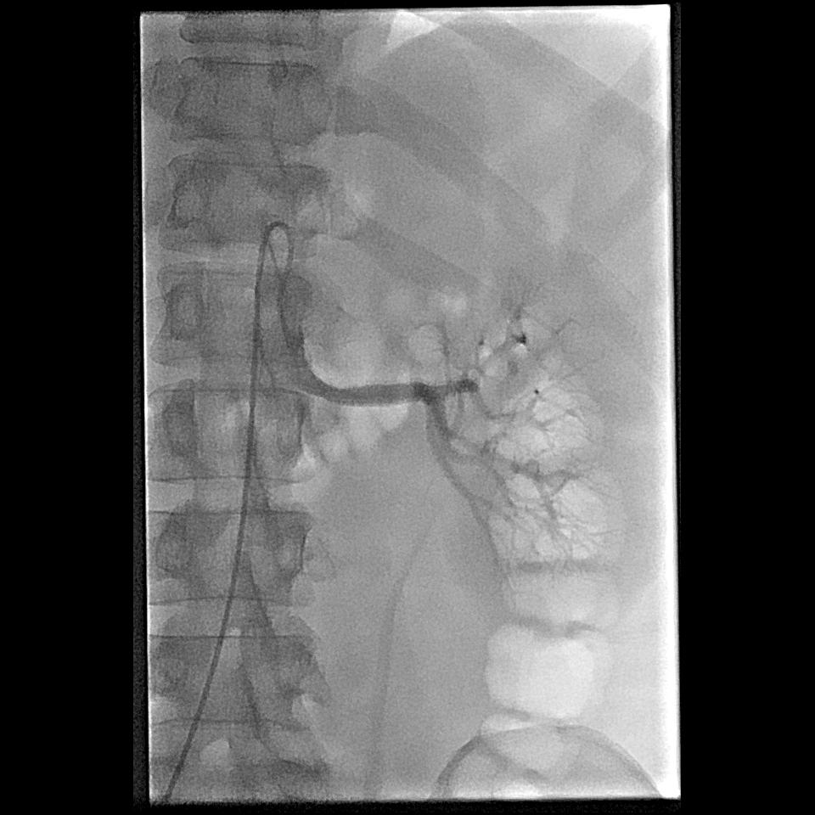
Case 1
Renal arteriography
- No stenosis in Lt renal artery

Slide 23
Case 1
Renal biopsy is not done
퇴원
- Nifedipine 60mg bid, bisoprolol 2.5 mg qd, HCT 25mg qd, hydralazine 25mg tid
6개월 후 외래 방문
- BUN/Cr 16.6/1.06
- RUPCR 0.4
- Medication: nifedipine 60mg qd, carvedilol SR 32mg qd, telmisartan/HCT 80/12.5mg qd

Slide 24
Case 2
F/17
CC : Headache
PI :
이전부터 학교 건강검진에서 혈압 160-170 나오곤 했으나 특별한 검사 나 치료를 받지 않았음. 3일 전부터 시야가 가려지고 흐려지는 증상이 있어 인근 안과 의원 방문하여 고혈압성 망막변화가 와있고, 혈압이 180 이상으로 높아 큰 병원 권유 받고 내원함.
V/S 220/160 - 60 - 20 - 36.6
Ht/Wt 155.8/68.5

Slide 25
Case 2
CBC 16,650 - 14.5 - 361K - Neut 72.3%
BUN/Cr 5.6/0.4
E’ 139 - 3.2 - 94 - 27, Calcium/Phosphorus 9.6/-
Total protein/Albumin 8.1/4.7, glucose 91, cholesterol 199, CRP 2.15
Total bilirubin 1.3, AST/ALT/ALP 16/19/125, LDH 285
U/A SG 1.015, pH 6.5, protein 1+, blood +/-, RBC 1-4/HPF, WBC 0-1/HPF

Slide 26
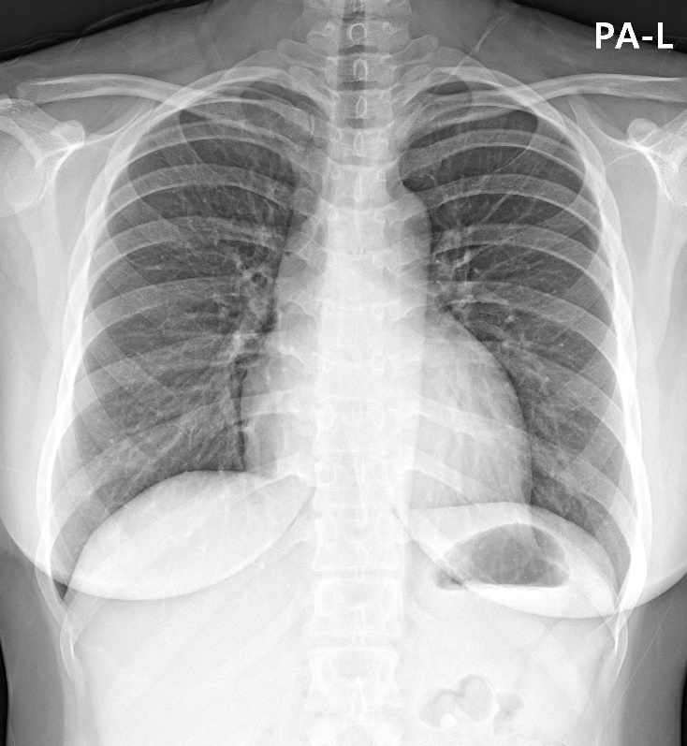
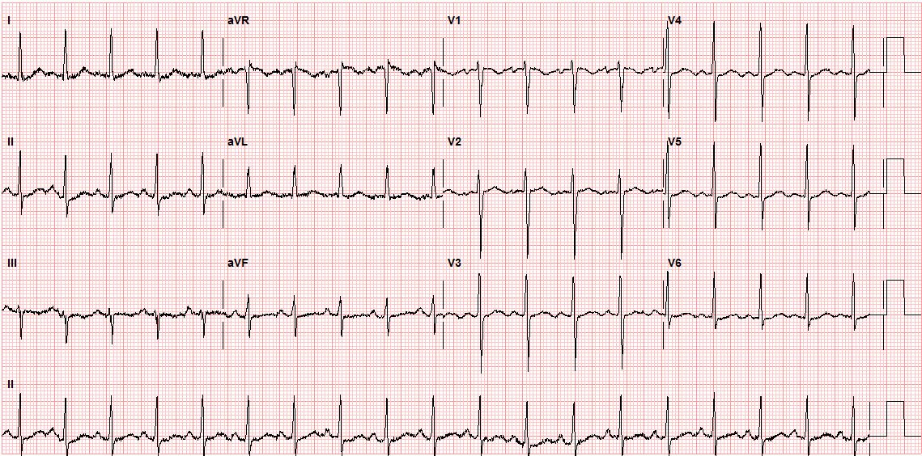
Case 2
IV nicardipine continuous infusion 하며 조절
Cardiac enzyme: normal

Slide 27
Case 2
Renin activity 38.5 ng/mL/hr, aldosterone 132.3 ng/dL
TFT : normal
24hrs urine
- VMA 1.8 mg, epinephrine 3.5 ug, norepinephrine 32.5 ug, metanephrine 0.2mg
FANA (-), anti-dsDNA (-), ANCA (-), anti Sm Ab (-), anti SS-A/Ro Ab (-), anti SS-B/La Ab (-)
RF 9 IU/mL, anti CCP Ab (-), C3 176, C4 60.2
EchoCG : normal

Slide 28
Case 2
Abdomen & pelvis CT
1. No mass in adrenal glands. No renal artery stenosis. 2. Multifocal decreased enhancing portions with decreased volume in both kidneys. --> Chronic inflammatory condition such as infarction or pyelonephritis. 3. Ill-defined low attenuation portion in spleen on arterial phase. - homogenous enhancement of spleen on delayed phase. --> R/O transient heterogenous enhancement on parterial phase DDx. ischemia. 4. Soft tissue density surrounding aorta, celiac trunk, SMA orifice, left renal artery, right renal artery orifice, IMA orifice. --> R/O Periaortitis or vasculitis.

Slide 29
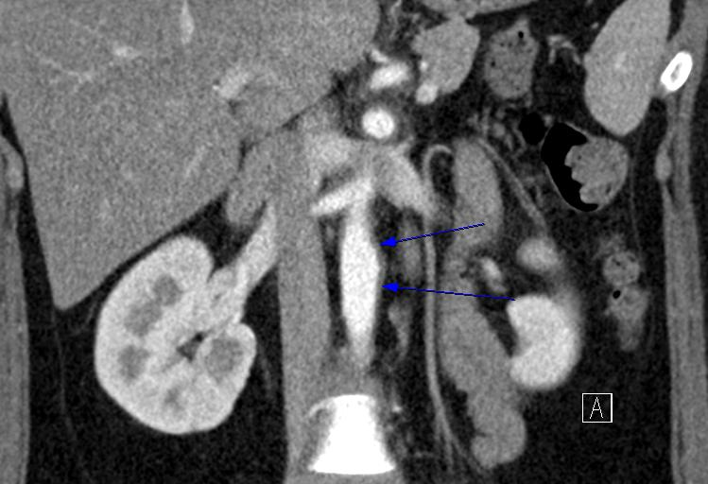
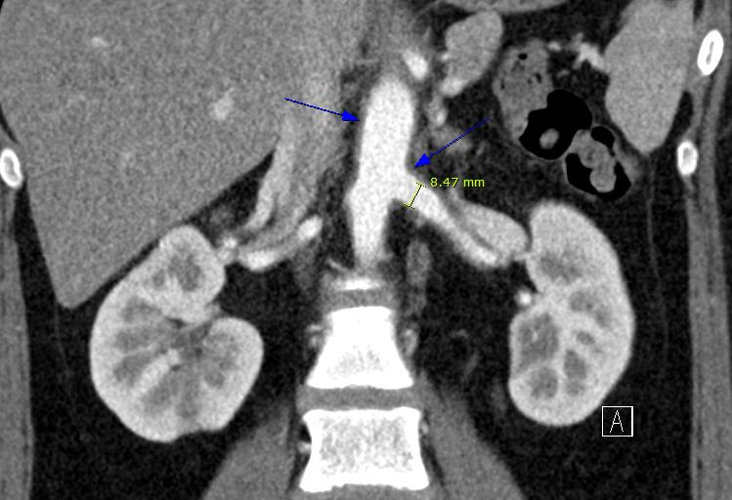
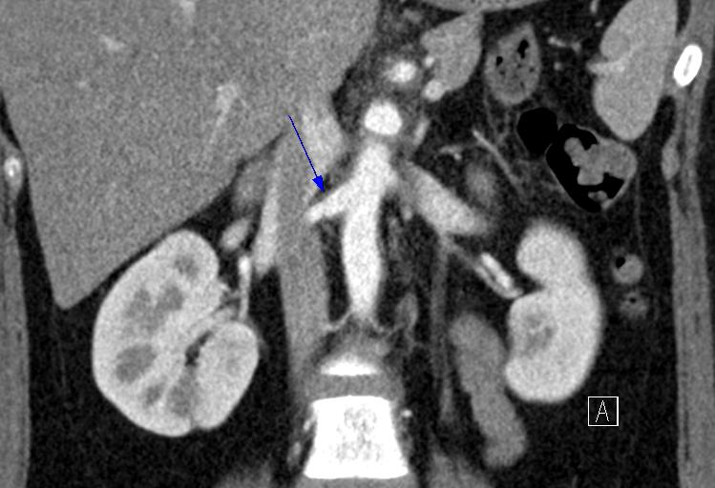
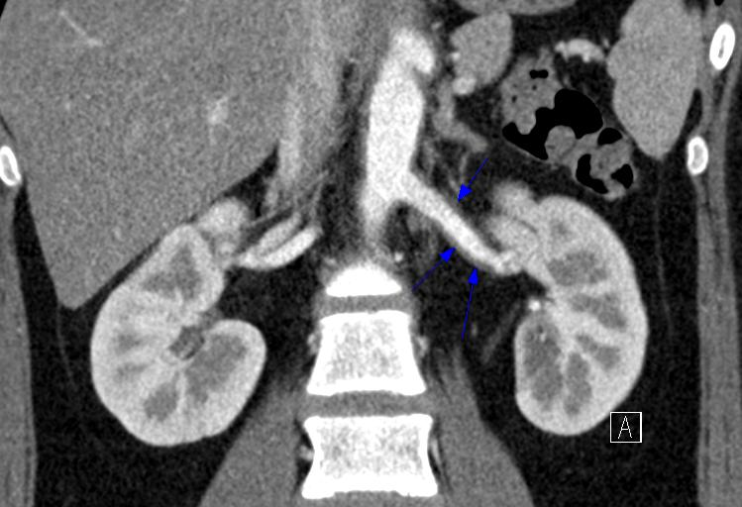

Slide 30
Case 2
Holter monitoring : normal, few PACs <1%, few PVCs <1%
Rheumatology 와 협진: r/o retroperitoneal fibrosis, r/o large vessel vasculitis
- Whole body PET : normal
- Serum IgG4 : normal
r/o retroperitoneal fibrosis → oral prednisolone 20mg qd, MTX 10mg qw 시작 이후
혈압약 요구량 변화
- Valsartan 160mg qd, nifedipine 30mg qd, spironolactone 25mg qd, bisoprolol 2.5mg qd
→ telmisartan 40mg qd, nebivolol 2.5mg qd

Slide 31
Summary
Hypertensive crisis
- Hypertensive emergency (target organ damage +)/hypertensive urgency
Various causes
Initial laboratory studies should be limited and rapidly expedited
Hypertensive emergency → rapid initial pharmacologic therapy needed
Initial management → evaluation and specific treatment

